Slide 1
Amazon Kindle

Slide 2
A Comprehensive Analysis of Amazon Kindle Publications from 1900 to January 2024, It scrutinizes reviews and ratings, providing insights into the best choices for readers, Editor's Picks, and the top-selling books.

Slide 3
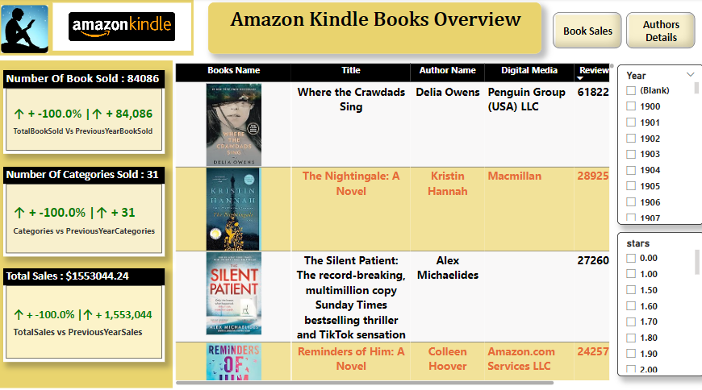
JEFF ZOS
Founder

Slide 4

Statistics
84,086
1.55 M
Books
Sales
The aggregate sales of books across the 31 different categories from the year 1900 to January 2024 total to 84,086 copies.
It has generated 1.55 million in sales on Amazon Kindle digital media, with a total of 84,086 books sold.
38
58.09 K
Digital Sold Media
Authors
All those books were sold by 38 digital media.
58.09K authors have published their books on Amazon Kindle.

Slide 5
The top-reviewed books:
The top four reviewed books are "Where the Crawdads Sing," "The Nightingale: A Novel," "The Silent Patient: The record-breaking multi-million copy Sunday Times bestselling thriller and TikTok sensation," and "Reminders of Him: A Novel
"Where the Crawdads Sing," written by Delia Owens, is sold by Penguin Group (USA) LLC and has been reviewed by 618,227 readers and received a rating of 4.70 stars.
"The Silent Patient: The record-breaking multi-million copy Sunday Times bestselling thriller and TikTok sensation, written by Alex Michaelides, has been reviewed by 272,608 readers and received a rating of 4.40 stars."
"The Nightingale: A Novel," written by Kristin Hannah, is sold by Macmillan and has been reviewed by 289,251 viewers and received a rating of 4.70 stars.
"Reminders of Him: A Novel, written by Colleen Hoover, and sold by Amazon.com Services LLC, has been reviewed by 242,575 readers and received a rating of 4.70 stars."
2015
2018
2019
2022

Slide 6
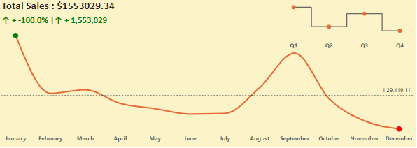
Growth Chart
"If we examine the Monthly Growth chart, we observe that from the year 1900 to January 2024, January consistently generated the highest number of sales, while December consistently recorded the lowest sales. Specifically, January contributed $177,237.87 to total sales, whereas December contributed $102,990.09."

Slide 7
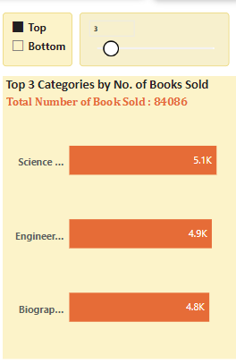
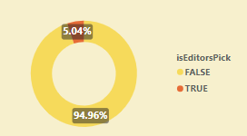
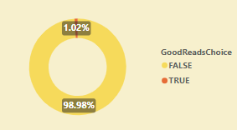
Market Share
"Among the 31 categories, the top three are Science & Math, Engineering and Transportation, and Biographies and Memoirs. Specifically, 5,093 books were sold in the Science & Math category, 4,928 in Engineering and Transportation, and 4,828 in Biographies and Memoirs."

Slide 8
thanks!

